Slide 1
Data Structure & Algorithms
BST (Binary Search Tree)

Slide 2
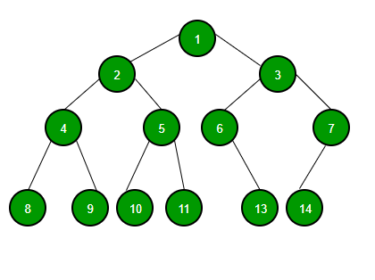
Binary Tree
A binary tree is a linked data structure in which each node is an object that contains following attributes:
a key and satellite data
left, pointing to its left child
right, pointing to its right child
p, pointing to its parent

Slide 3
Binary Tree
Each node in the binary tree is termed as either a parent node or as a child node.
The topmost node of the Binary Tree is referred to as the root node. Each parent node can have at most 2 child nodes which are the left child node and the right child node.
A binary tree is a recursive structure
Particular kinds of nodes:
Root
Leaves

Slide 4
Binary Tree - Definition
struct node { int data; struct node* left; struct node* right; };

Slide 5
Maximum Depth or Height of a Tree
Height of a tree: longest path from the root to one of the leaves; max(heights of subtrees) + 1
int maxDepth(struct node* node) { if (node == NULL) return 0; else { /* compute the depth of each subtree */ int lDepth = maxDepth(node->left); int rDepth = maxDepth(node->right); /* use the larger one */ if (lDepth > rDepth) return (lDepth + 1); else return (rDepth + 1); } }

Slide 6
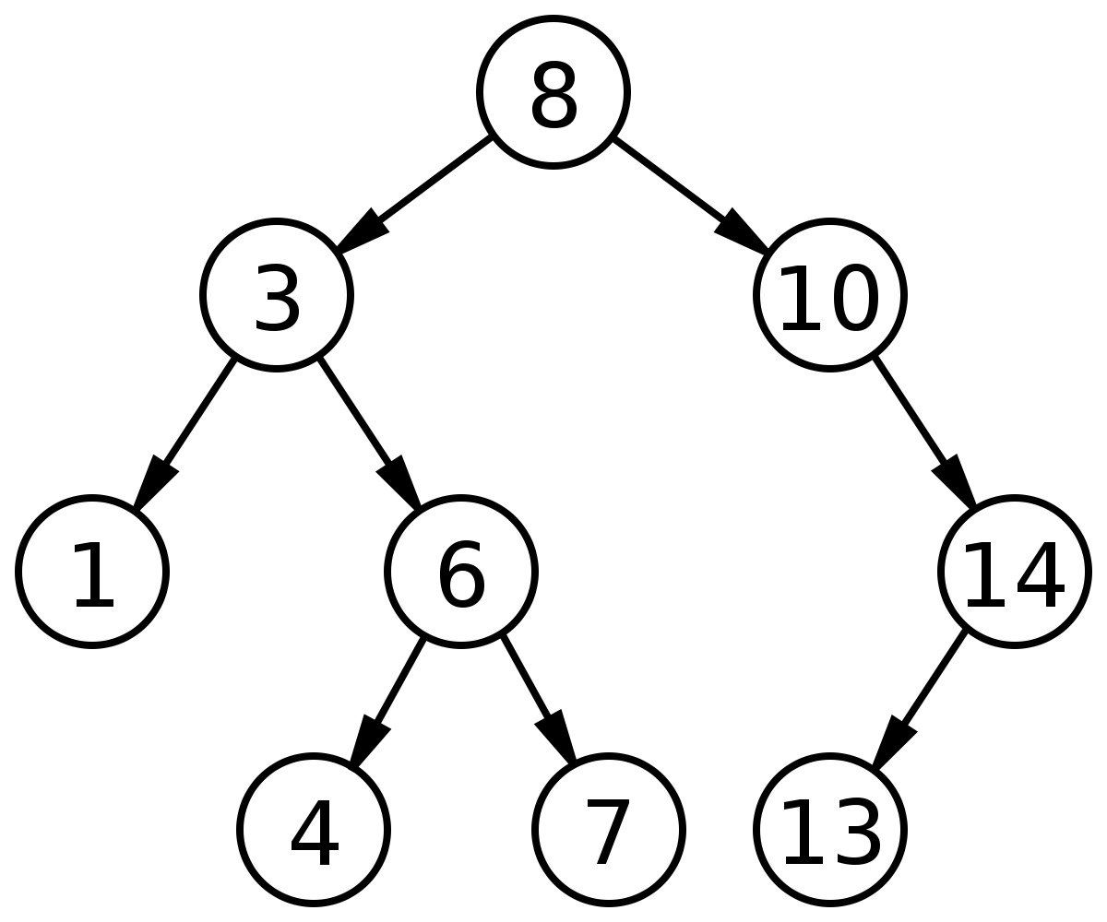
Binary Search Tree
A binary tree is a linked data structure in which each node is an object that contains following attributes:
a key and satellite data
left, pointing to its left child
right, pointing to its right child
p, pointing to its parent
A binary tree is a recursive structure
Particular kinds of nodes:
Root
Leaves
Height of a tree: longest path from the root to one of the leaves; max(heights of sub-trees) + 1

Slide 7

Binary Search Tree cont.
Binary-search-tree property
For any node $x$,
$Key[ y ] ≤ Key[x]$ if $y$ in left sub-tree of $x$
$Key[ x ] ≤ Key[ y]$ if $y$ in right sub-tree of $x$

Slide 8
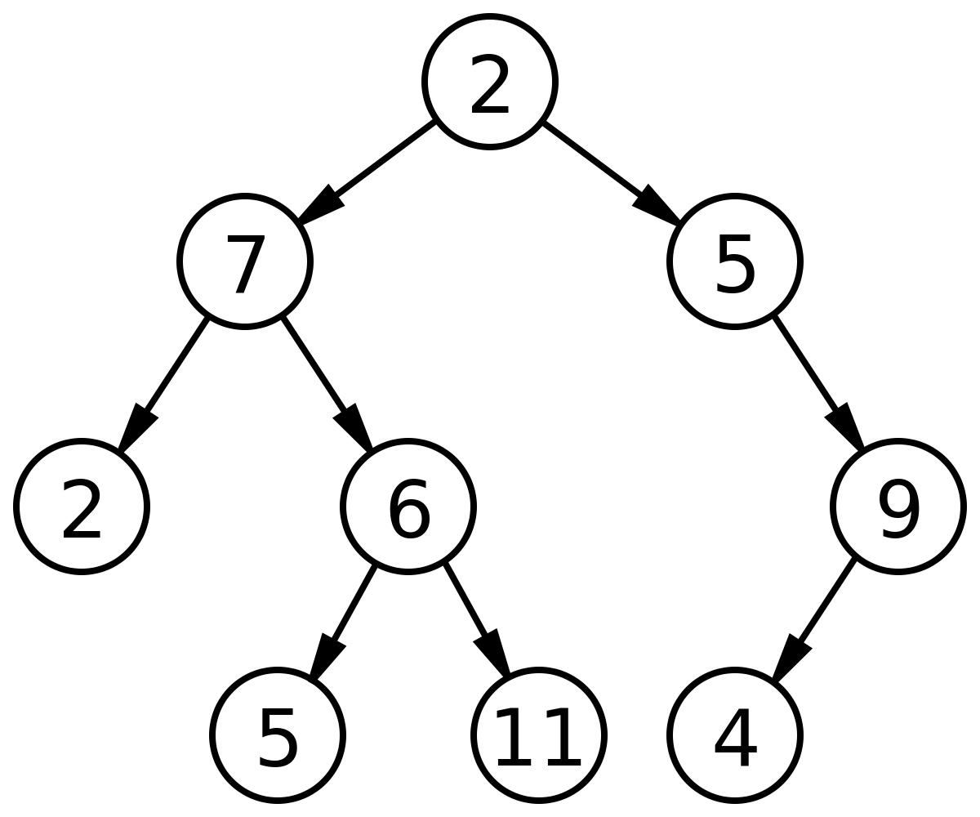
Counterexample – NOT a BST !

Slide 9
Tree Walks (Traversals)
The binary-search-tree property allows us to print out all the keys in a binary search tree in sorted order by a simple recursive algorithm, called an in-order tree walk.
This algorithm is so named because it prints the key of the root in between printing the values in its left sub-tree and printing those in its right subtree.
Post-order: print sub-trees first, then print root
Pre-order: print root first, then print sub-trees

Slide 10
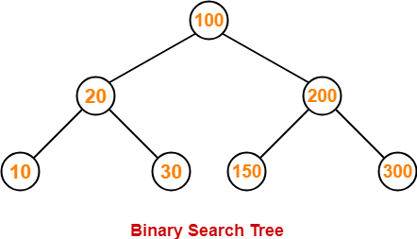
Example – Tree walks
Preorder Traversal-
100 , 20 , 10 , 30 , 200 , 150 , 300
Inorder Traversal-
10 , 20 , 30 , 100 , 150 , 200 , 300
Postorder Traversal-
10 , 30 , 20 , 150 , 300 , 200 , 100

Slide 11
In-order traversal
void inorder(struct node* root){ if(root == NULL) return; //recursively traverse left subtree first inorder(root->leftChild); //traverse current node printf("%d ", root-data); // recursively traverse right subtree lastly inorder(root->rightChild); }

Slide 12




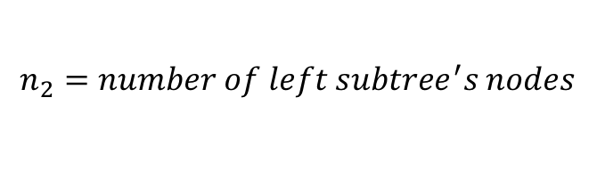
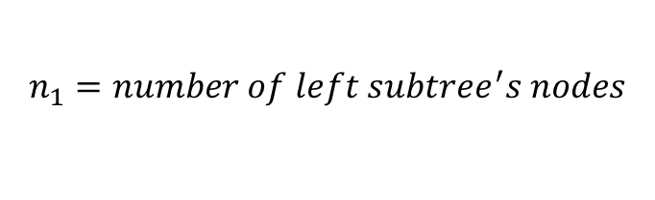
In-order – Time Complexity
$$T(n)=T(n1 )+T(n2 ) + θ(1)$$
$$n_{1}=number of left subtree^{′}s nodes$$
$For the roo$t
$$n_{2}=number of left subtree^{′}s nodes$$
$T\left(n_{1}\right)=T\left(n_{11}\right)+T\left(n_{12}\right)$ $+ θ(1)$
$T\left(n_{2}\right)=T\left(n_{21}\right)+T\left(n_{22}\right)$ $+ θ(1)$
.
.
.
.
.
.

Slide 13




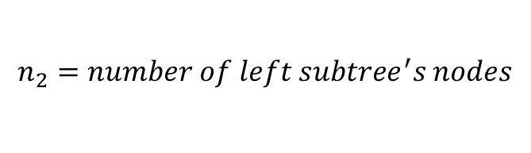
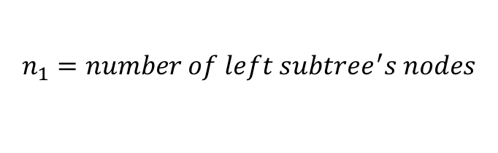
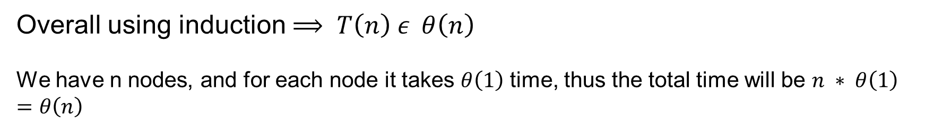
In-order – Time Complexity cont.
$T\left(n\right)=T\left(n_{1}\right)+T\left(n_{2}\right)$ $+ θ(1)$
$$n_{1}=number of left subtree^{′}s nodes$$
$$For the root$$
$$n_{2}=number of left subtree^{′}s nodes$$
$T\left(n_{1}\right)=T\left(n_{11}\right)+T\left(n_{12}\right)$ $+ θ(1)$
.
.
.
$T\left(n_{2}\right)=T\left(n_{21}\right)+T\left(n_{22}\right)$ $+ θ(1)$
.
.
.
Overall using induction $⟹ T\left(n\right) ε θ\left(n\right)$
We have n nodes, and for each node it takes $θ\left(1\right)$ time, thus the total time will be $n ∗ θ\left(1\right)$ $=θ\left(n\right)$

Slide 14
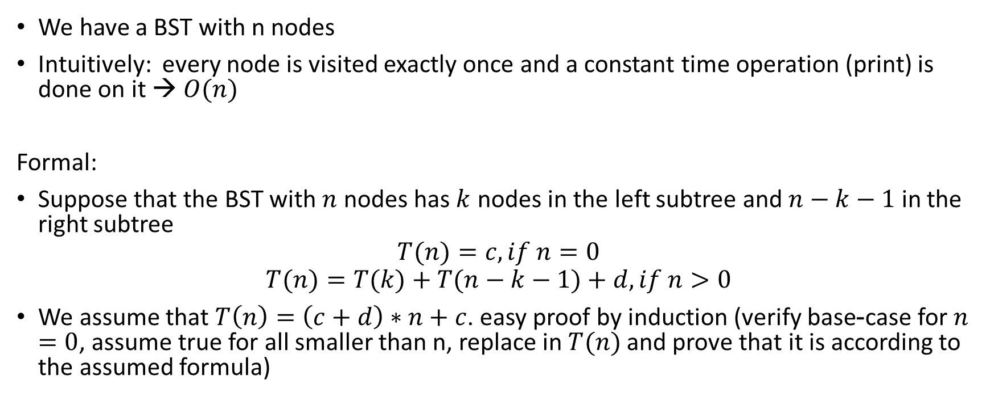
In-order – Time Complexity cont.
We have a BST with n nodes
Intuitively: every node is visited exactly once and a constant time operation (print) is done on it → $O(n)$
Formal:
Suppose that the BST with $n$ nodes has $k$ nodes in the left subtree and $n−k−1$ in the right subtree
$$T(n)=c, if n=0$$
$$T(n)=T(k)+T(n−k−1)+d, if n>0$$
We assume that $T\left(n\right)=\left(c+d\right)∗n+c$. easy proof by induction (verify base-case for $n=0$, assume true for all smaller than n, replace in $T(n)$ and prove that it is according to the assumed formula)

Slide 15
Search on a BST - Example
6<10
left
10
Search for k=6,
return pointer x to node
containing k
6>4
4
15
right
1
6
20
2
5
8
18
23

Slide 16
Search – Recursive Version - Algorithm
Tree-Search(x, k) 1 if x == NIL or K == x.key 2 return x 3 if k < x.key 4 return Tree_Search(x.left, k) 5 else return Tree_Search(x.right, k)

Slide 17
Search – Recursive Version - Code
// C function to search a given key in a given BST struct node* search(struct node* root, int key) { // Base Cases: root is null or key is present at root if (root == NULL || root->key == key) return root; // Key is smaller than root's key if (key < root->key) return search(root->left, key); // Key is greater than root's key return search(root->right, key); }

Slide 18

Search – Recursive Version – Time Complexity
For each level of tree it takes constant time (according to code) → Total time will be:
Height of tree * Constant Time
Overall: $T\left(n\right)∈O\left(h\right)$ → $T\left(n\right)∈O(logn)$

Slide 19
Search – Iterative Version - Algorithm
Iterative-Tree-Search(x, k) 1 while x != NIL and k != x.key 2 if k < x.key 3 x = x.left 4 else x = x.right 5 return x

Slide 20
Search – Iterative Version - Code
// Function to check the given key exist or not bool iterativeSearch(struct Node* root, int key) { // Traverse until root reaches to dead end while (root != NULL) { // pass right subtree as new tree if (key > root->data) root = root->right; // pass left subtree as new tree else if (key < root->data) root = root->left; else return true; // if the key is found return 1 } return false; }

Slide 21
Search – Iterative Version – Time Complexity
For each level of tree it takes constant time (according to code) → Total time will be:
Height of tree * Constant Time
Overall: $T\left(n\right)∈O\left(h\right)$ → $T\left(n\right)∈O(logn)$

Slide 22
Finding Minimum and Maximum - Example
Search nodes with
minimum and
maximum key values
left
10
right
left
4
15
right
1
6
20
right
2
5
8
18
23

Slide 23
Finding Minimum and Maximum - Algorithm
Tree-Minimum(x) 1 while x.left != NIL 2 x = x.left 3 return x

Slide 24
Finding Minimum and Maximum - Code
int minValue(struct node* node) { struct node* current = node; /* loop down to find the leftmost leaf */ while (current->left != NULL) { current = current->left; } return(current->key); }
Time complexity: $T\left(n\right)∈O\left(h\right)→T\left(n\right)∈O(logn)$

Slide 25
Finding Minimum and Maximum - Algorithm
Tree-Maximum(x) 1 while x.right != NIL 2 x = x.right 3 return x

Slide 26
Finding Minimum and Maximum - Code
int maxValue(struct node* node) { struct node* current = node; /* loop down to find the leftmost leaf */ while (current->right != NULL) { current = current->right; } return(current->key); }
Time complexity: $T\left(n\right)∈O\left(h\right)→T\left(n\right)∈O(logn)$

Slide 27

Finding Successor
Successor($x$)
The node y with the smallest key greater than or equal to $x.key$
Ambiguous when multiple nodes have same key
Successor in the in-order tree walk
Return Nil if none exists -- has largest key

Slide 28

Finding Successor cont.
We have two cases in the process of finding successor:
If right child of $x$ exists
Leftmost node in right sub-tree
Otherwise
Lowest ancestor $y$ where $x$ is in the left-sub-tree of $y$

Slide 29
Finding Successor cont.
Tree-successor(x) if (x.right ≠ NULL) return Tree-minimum(x.right) y = x.parent while (y ≠ NULL and x = y.right) x = y y = y.parent return y

Slide 30
Finding successor - Example
10
x
Find the node y which
contains the successor of
a given node x
4
15
1
6
20
2
5
8
18
23

Slide 31
Finding successor – Example cont.
10
y
Find the node y which
contains the successor of
a given node x
4
15
1
6
20
2
5
8
18
23
x
3

Slide 32
Finding successor - Algorithm
Tree-successor(x) if (x.right ≠ NULL) // Case 1 return Tree-minimum(x.right) // Case 2 y = x.parent while (y ≠ NULL and x = y.right) x = y y = y.parent return y

Slide 33
Finding Successor – Time Complexity
For each level of tree it takes constant time (according to code) → Total time will be:
Height of tree * Constant Time
Overall: $T\left(n\right)∈O\left(h\right)$ → $T\left(n\right)∈O(logn)$

Slide 34
Finding Predecessor
We have two cases in the process of finding predecessor :
The left child of x exists
Rightmost child in the left sub-tree of x
Otherwise
Lowest ancestor y where x is in the right sub-tree of y.
Completely symmetric

